Slide 1

TEAM 6: MONESA WEB

Slide 2
CONTENT
Introduction
Project management
Software requirement
Software architecture
Software testing

Slide 3
TEAM MEMBER
20127553 Nguyễn Tiến Lợi
20127509 Lu Phi Hùng
20127184 Hà Huỳnh Đức Huy
20127259 Huỳnh Thành Nguyên
20127528 Quách Vĩnh Khang

Slide 4
1
Introduction

Slide 5

Purpose
Web application that simplifies personal money management by integrating all accounts such as banks and cash in one location.

Slide 6
PROBLEM STATEMENT
The problem of | Manage expenses in a rudimentary way.
affects | Those who have a hard time managing their spending.
the impact of which is | Waste of time and effort, and subjective calculations might lead to confusion.
a successful solution would be | It assists users in effectively and scientifically managing their spending.

Slide 7
Product Position Statement
For | Student. Entrepreneur. Housewives and other family members. Office employees need to compile income and spending figures. People have an average or low income.
Who | It's easy to keep track of income and expenses. Create a budget for the future. You won't have to be concerned about out-of-control spending any more.

Slide 8
Product Position Statement
The (product name) | Monesa Website
That | Create an income and expense management system for individuals and groups: Manage revenue and expense categories. Manage wallets (Default: cash). Manage currency (Default: VND). Manage income and expense caps (by day, month, and year, with a warning system). Look up demand-driven expenditure.
Unlike | Users keep track of their rudimentary expenditures.
Our product | Provide online budgeting services that are quick, easy to use, and secure.

Slide 9
USER AND MARKET
Actors:
Admin: the website master.
Customers : Customers have statistical spending needs.
Market: all users who desire a website with statistics on spending

Slide 10
PLATFORM AND USER
Actor: Inlcude 2 actors admin, customer
Operator platform: Web
Develop platform:
NodeJS
ReactJS

Slide 11
2
Project management

Slide 12
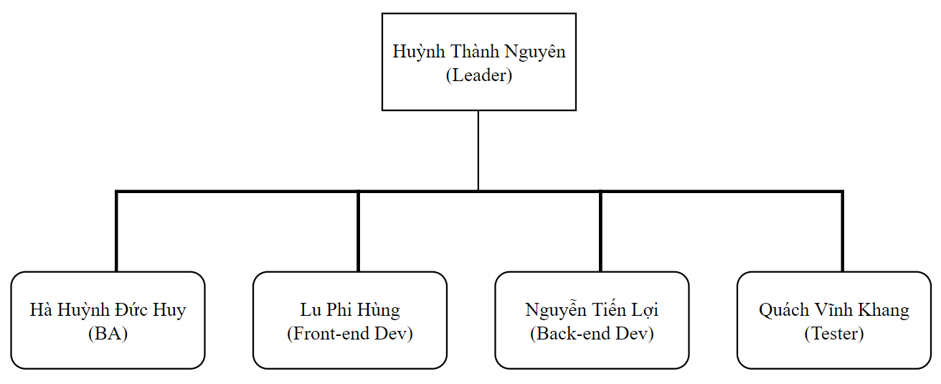
2.PROJECT MANAGEMENT Team structure

Slide 13
2.PROJECT MANAGEMENT Responsibilities
Person | Role
Huỳnh Thành Nguyên (Team leader, Full-stack Dev) | Assign tasks, motivate team members. Design and build barebone of website
Hà Huỳnh Đức Huy (BA, Front-end Dev) | Analyze and note requirements for Website and documentation. Design UI and apply animation for Website.
Lu Phi Hùng (UI Designer, Front-end Dev) | Design UI and improve UX for Website.
Nguyễn Tiến Lợi (Back-end Dev, Tester) | Design website behavior, build database. Testing website function.
Quách Vĩnh Khang (Back-end Dev, Tester) | Cooperate in designing website behavior, build database. Testing website function.

Slide 14
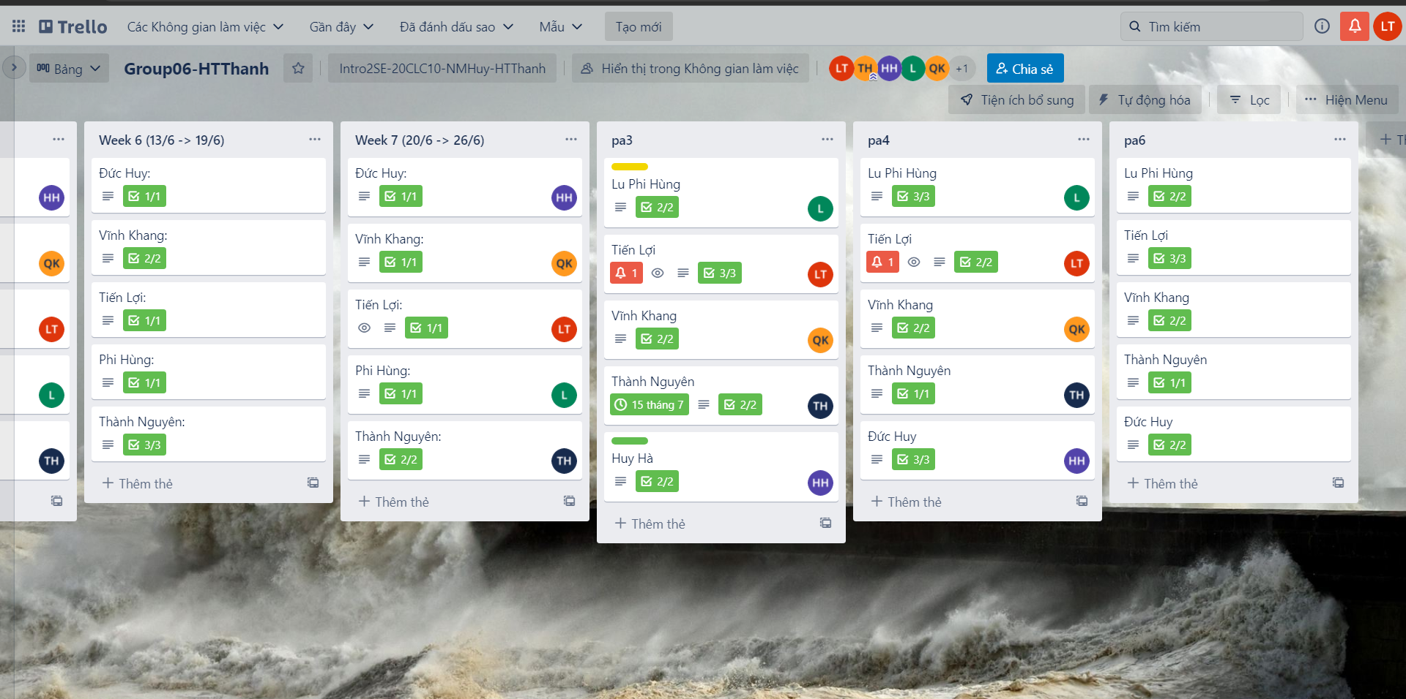
2.PROJECT MANAGEMENT Trello activities

Slide 15
3
Software Requirement

Slide 16
3.PROJECT Requirement Use Case

Slide 17
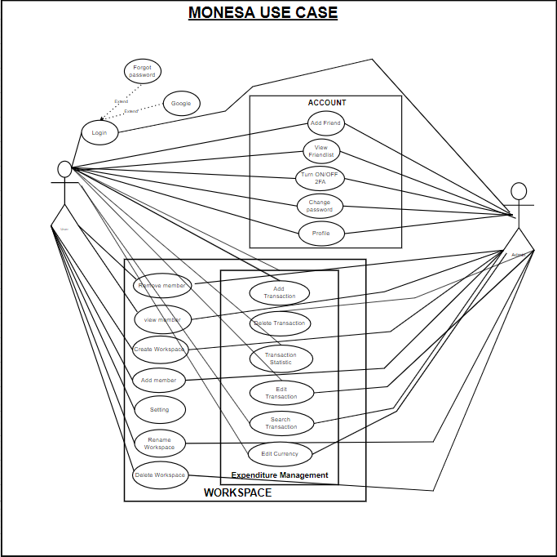

Slide 18
3.PROJECT Requirement FUNCTIONAL REQUIREMENTS
-Register
-Log in
-Reset password
-Add transaction
-Delete transaction
-Edit transaction

Slide 19
3.PROJECT Requirement NON-FUNCTIONAL REQUIREMENTS
REQUEST TAKES NO LONGER THAN 1 MINUTES IS THE MAIN NON-FUNCTIONAL REQUIREMENTS OF OUR WEBSITE

Slide 20
4
Software architecture

Slide 21
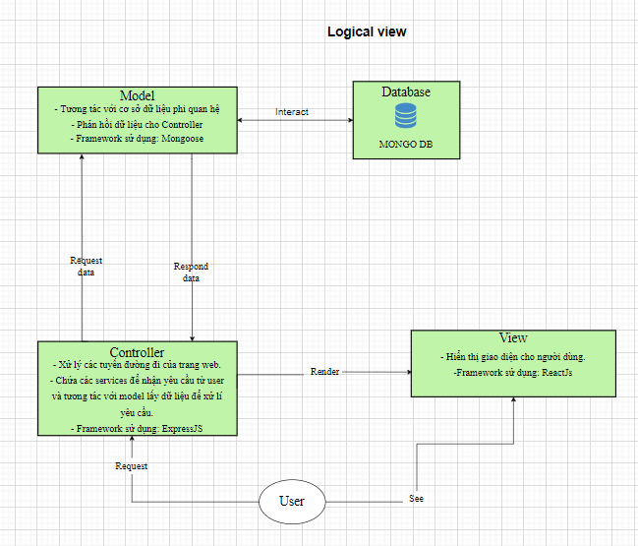
4. Software architecture MVC MODEL

Slide 22
4. Software architecture MODEL

Slide 23
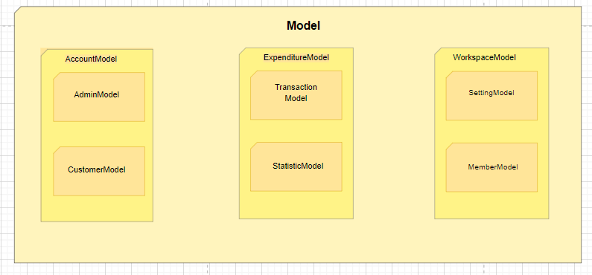
4. Software architecture MODEL

Slide 24
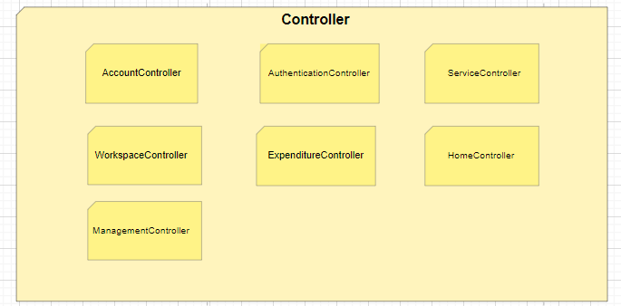
4. Software architecture CONTROLLER

Slide 25
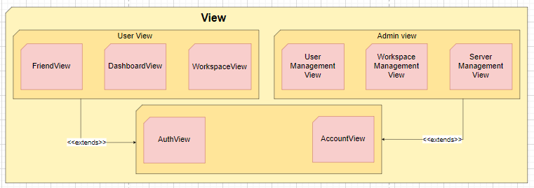
4. Software architecture VIEW

Slide 26
5
Software testing

Slide 27
5. Software testing
ID | Feature Name | Description | Remark
UC01 | Register | Allow user to create their account
UC02 | Log In | Allow user to log in with his/her own account
UC03 | Reset Password | Allow user to reset password
UC04 | Log In with Google | Allow user to log in with his/her google account
UC05 | Add Transaction | Allow user to add transaction
Testing skill :
Usability testing
Functional testing

Slide 28
5. Software testing
Number of functions | 5
Number of test cases | 13
Number of passed test cases | 11
Number of failed test cases | 2
Number of bugs | 2

Slide 29
THANKS!
Any questions?
You can find me at @username & user@mail.me

